Slide 1



Driver Drowsiness Detection Based on Eye Aspect Ratio
Under Guidance of
Dr. Shailendra Tiwari
Departement of Computer Science and Engineering
Batch of COE
Kavitash Kumar 101903476
Chandresh Sharma 101903485
Samar Deol 101903158
Using OpenCV
Ayushi Mahajan 101903227
with dlib package

Slide 2



Objective
As AIIMS Neurology India's research has found, more than 20% of all road accident victims are found suffering from sleep disorders.
Another study revealed that more than 23% of truck drivers have sleep deprivation.
Many drivers face fatal accidents when they sleep or feel drowsy while driving
Hence, To overcome this problem, Driver Drowsiness Detection system is used.
The main objective of this system is to detect whether the person is feeling sleepy or whether the person’s eyes are closed for a few seconds or not. This system will alert the driver when drowsiness is detected.

Slide 3


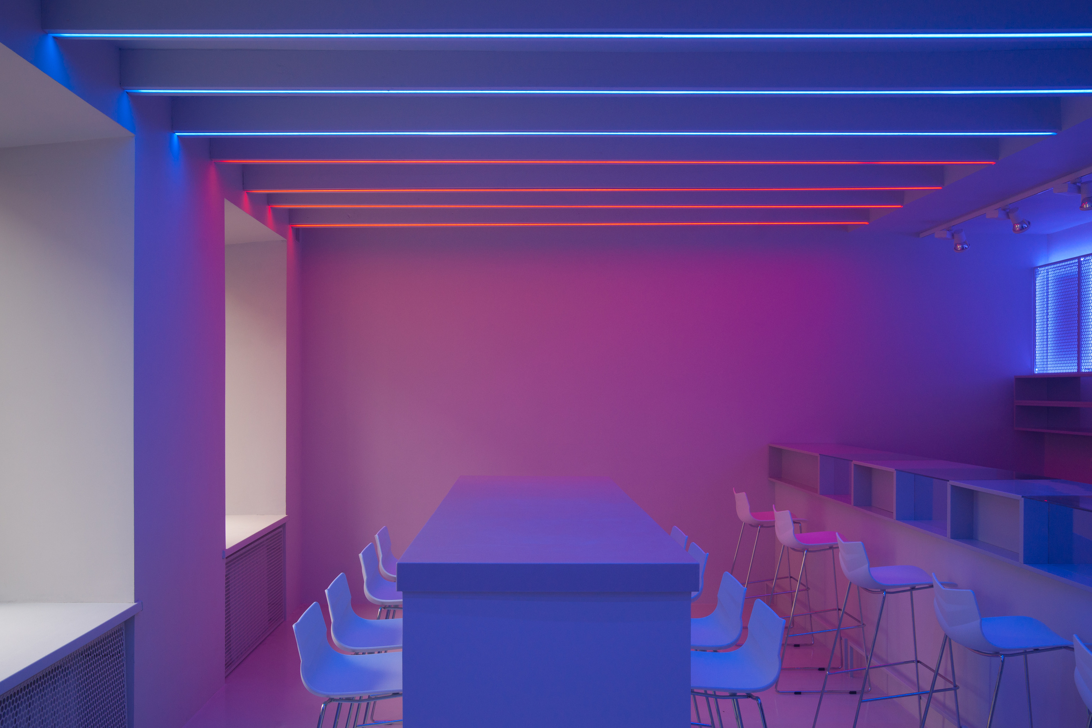
In 2011, M.J. Flores explained the driver sleep detection system under the infrared light of a smart car. He used Artificial Intelligence algorithms to process visual information to detect , track and analyze both the driver's face and eyes to calculate indications of drowsiness and disturbance.
In June 2012, A. Cheng explained Driver Sleep Recognition Based on Computer Visual Technology. A solid eye tracking algorithm was introduced to address the problems caused by changes in light and position of the driver.
In 2013, G. Kong defined Visual Analysis of the Situation and Position of the Head of Driver Monitoring. They introduced visual analysis of eye state and head pose to monitor the vehicle driver. The SVM is employed to divide the sequence of video segments into warning or non-warning driving events.
Literature
Survey

Slide 4



Proposed
Work
In this project, We proposed a system which would observe the status of the driver, whether the driver is feeling sleepy or if the driver is yawning.
Two types of alarms in this system
1. When the driver sleeps or feels drowsy for more than 4 sec, it would give an alert to the driver.
2. When driver drives 12 hours continously, an alert delivered to the driver to stop driving .
.
Steps Involved :
Face Detection
.
It Uses HOG( Histogram Oriented Gradient) to detect object and it is integrated with dlib library
SVM is also used here to detect faces and classify facial features from non-facial features

Slide 5



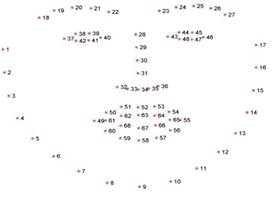
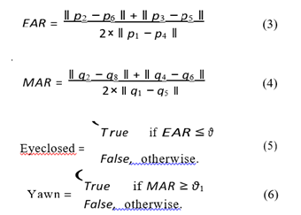

Face Recognition
Dlib facial landmarks
Histogram of Local Binary Pattern is used
Illumination invariant and work by dividing the image into specific pixel cells
Calculates the histogram of different people and computes the difference between the histograms
EAR and MAR
Drowsiness alert using dynamic timer
Consecutive eye (CE) is the non-stop frame threshold for Eye (55)
Consecutive mouth(CM) is the non-stop frame threshold for Yawning (95)
The driving time of a driver and sensitivity of the program is inversely proportional to thresholds of continuous frames of eyes and mouth.

Slide 6

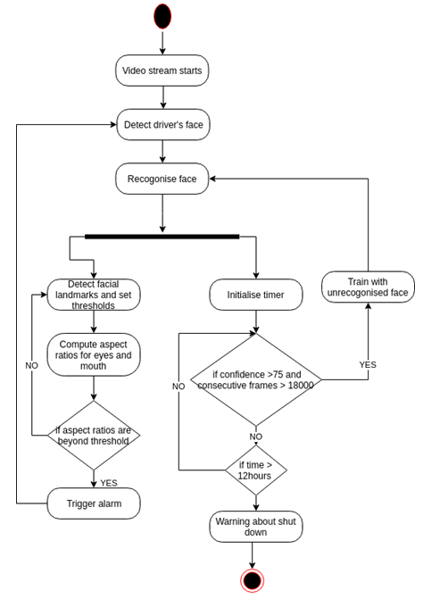
Block Diagram

Slide 7

WORKING PRINCIPLE
Based on an algorithm which recognizes changes over the course of long trips.
Phases include typical signs of waning concentration like driver is barely steering or closed eyes.
Other parameters are length of a trip, use of turn signals, and time of the day.
Function calculates driver's level of fatigue depending on these moments.
If that level exceeds a certain value, an icon flashes to warn the drivers that they need a rest.

Slide 8
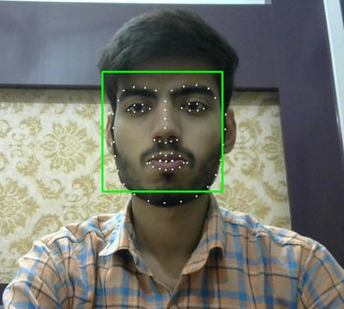
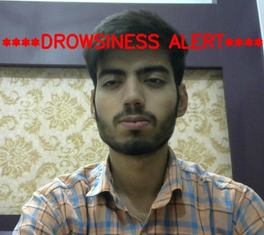
Experimental Analysis
For Drowsiness alert, the 68 Facial Landmark points are used to calculate the EAR(Eye Aspect Ratio) and MAR(Mouth Aspect Ratio) of the scanned and recognized face. The initial threshold values for eyes and mouth have been set with continuous frame thresholds of 55 and 95 respectively.
Phase 1 - This phase has a static threshold. Drowsiness is generated when CM achieves the continuous frames threshold for lips and CE achiieves the continuous frames threshold for eyes.
Phase 2 - The threshold values of continuous frames for eyes and lips are gradually decreased as compared to the computed EAR and MAR for drowsiness alert. As a result , the system will notify the driver significantly sooner.

Slide 9
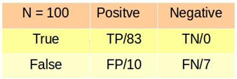
Experimental Analysis
The real time accuracy of our proposed system is 90%. Most of the times it correctly detect drowsiness and triggered the alarm. Failure cases are when driver is not towards camera, our proposed framework is not able to detect the drowsiness. This is quite obvious, camera is mounted at front and when the driver is looking towards left, right or may be bend, proposed system will detect it as non-face so further processing stopped. We calculated the accuracy using sensitivity formula.
We took 100 samples and 83 times it correctly classifies and 10 times it misclassified.
Accuracy and Time Analysis
Provide a three-year forecast containing dollars and key metrics such as the number of customers and conversion rate. Do a bottom-up, not top-down, analysis.

Slide 10
Purpose of our project is to help solving real life problem in very cost effect way. It alerts the truck driver as well as the owner of the company. Whenever the driver feels drowsy and closes his eyes for more than a second, the buzzer is blown. As a result, it alerts the driver. It also warns the owner of the truck driver by sending him text messages. As a result the accident ratio decreases. Hence, our project if commercially developed will help in saving the precious life of truck driver & money of the owner.
Coming to future scope this system can be further extended to have security like only certain people can access the vehicle. In case of theft, the vehicle does not start and an mms of the burglar could be sent to the owner of the vehicle.
Conclusion and Scope

